Slide 1

Creating PRP with the PureSpin® System

Slide 2
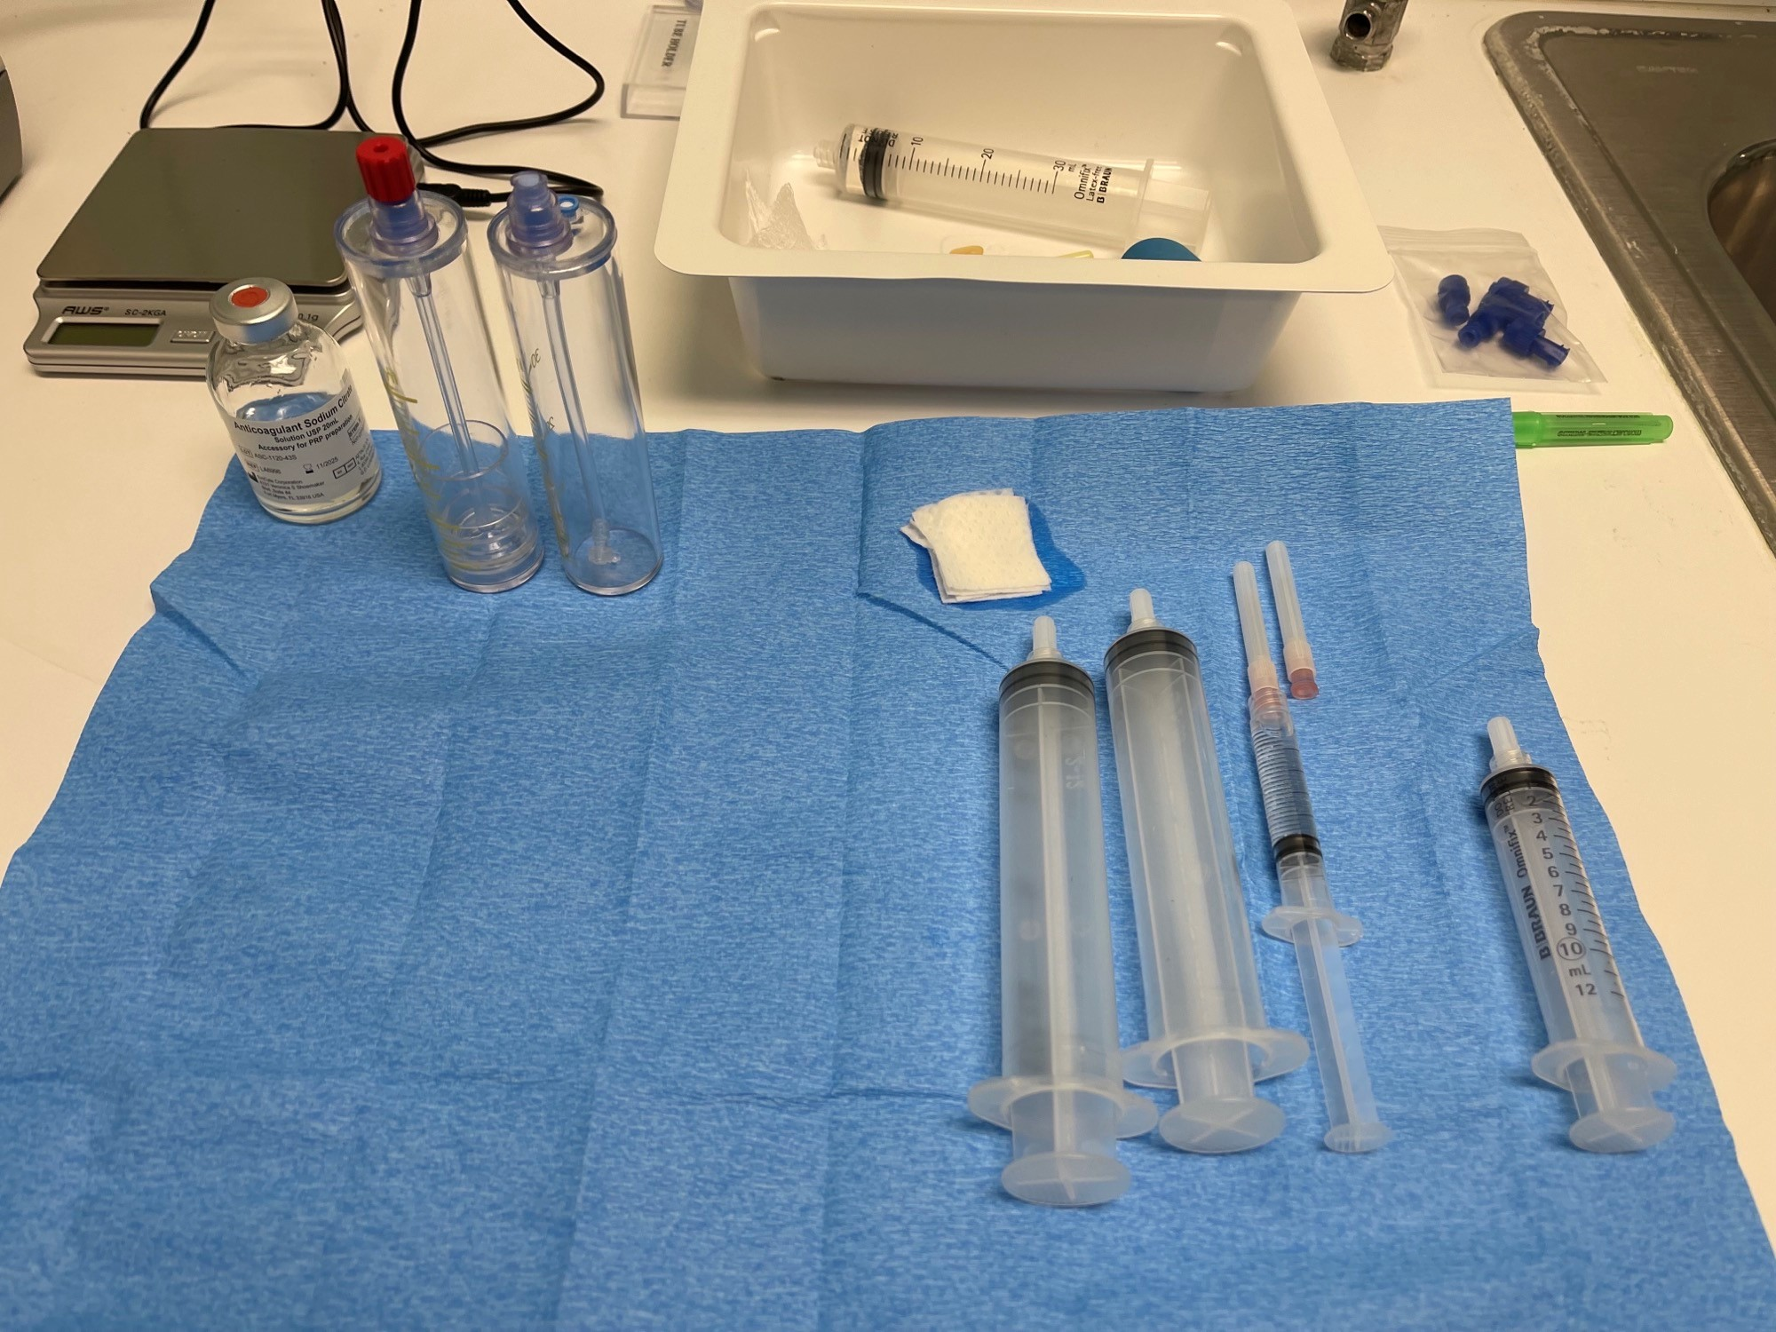
Setting up your workstation
Add anti-coagulant (sodium citrate) to the syringe for blood collection
30cc Kit - 3cc Sodium Citrate
60cc Kit - 5cc Sodium Citrate

Slide 3
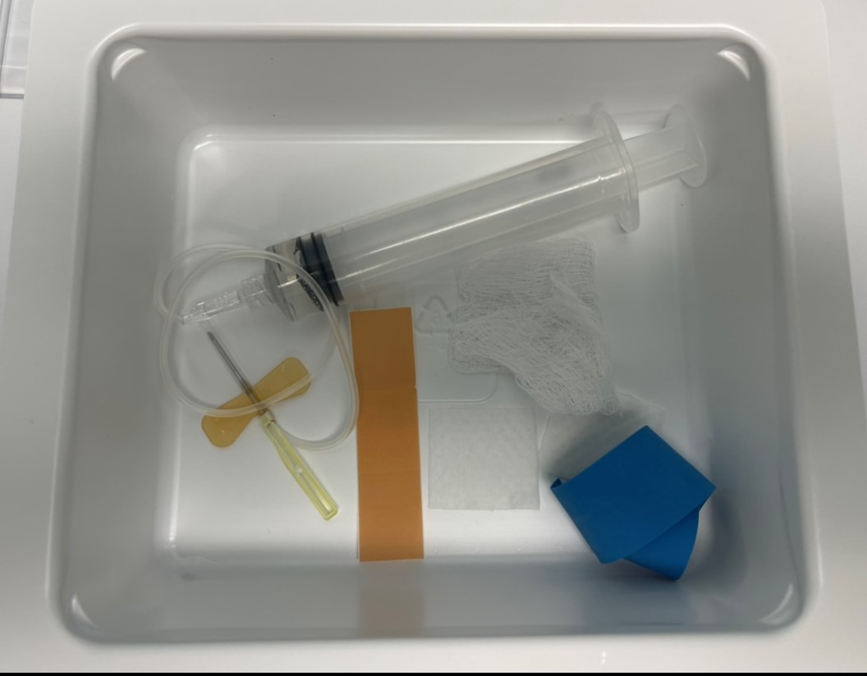
Drawing the blood
Attach syringe to 19g butterfly
19g needle is ideal to decrease the risk of lysing platelets….but it is not always possible
Use a 21g needle in patients with veins not adequate enough to use the 19g

Slide 4
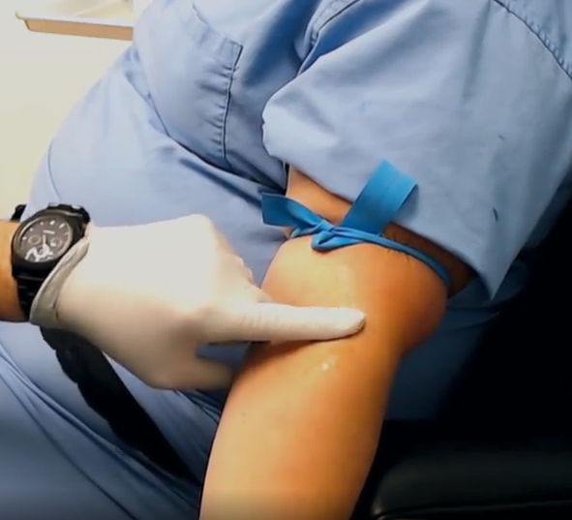
Remember the 3 T’s
If you initially do not see a “good” vein…..
• Tighten Tourniquet
• Time (Keep tourniquet in place for
2-3 minutes
• Tap the vein to bring it to the
surface

Slide 5
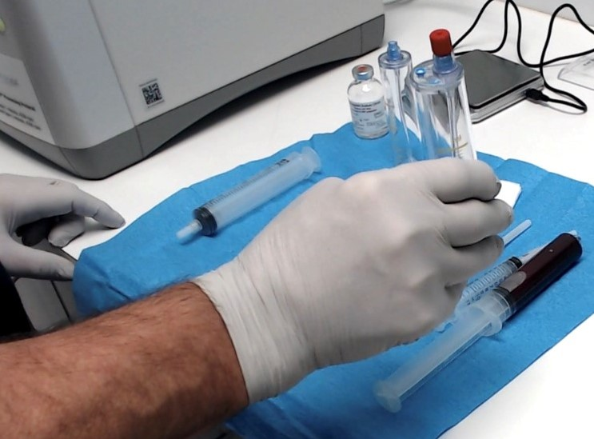
Place blood in concentrating tube
Luer-lock connectors (twist clockwise). The luer-lock prevents any contaminants from entering the blood.
Red (whole) blood goes in red capped tube

Slide 6
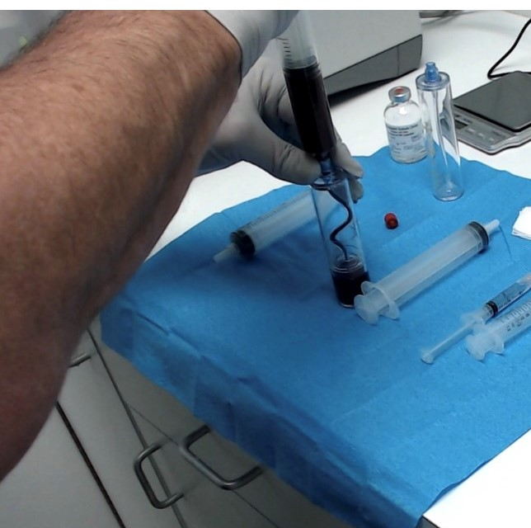
Slowly add whole blood to collection device, as not to damage platelets

Slide 7
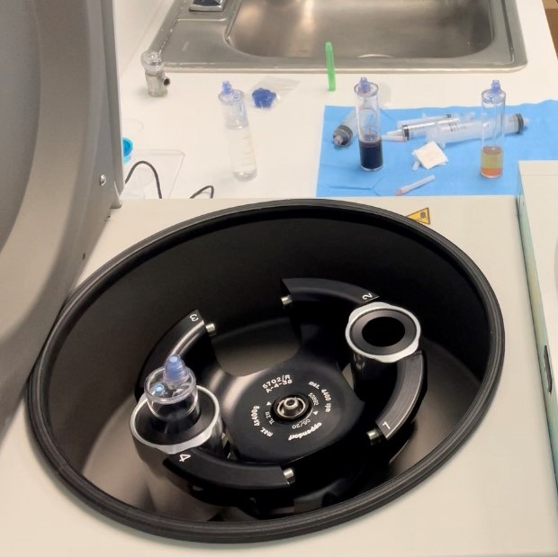
Place in centrifuge
Balance with water filled counterbalance tube
Weight must be within 4 grams
Place blood in centrifuge bucket opposite counterbalance

Slide 8
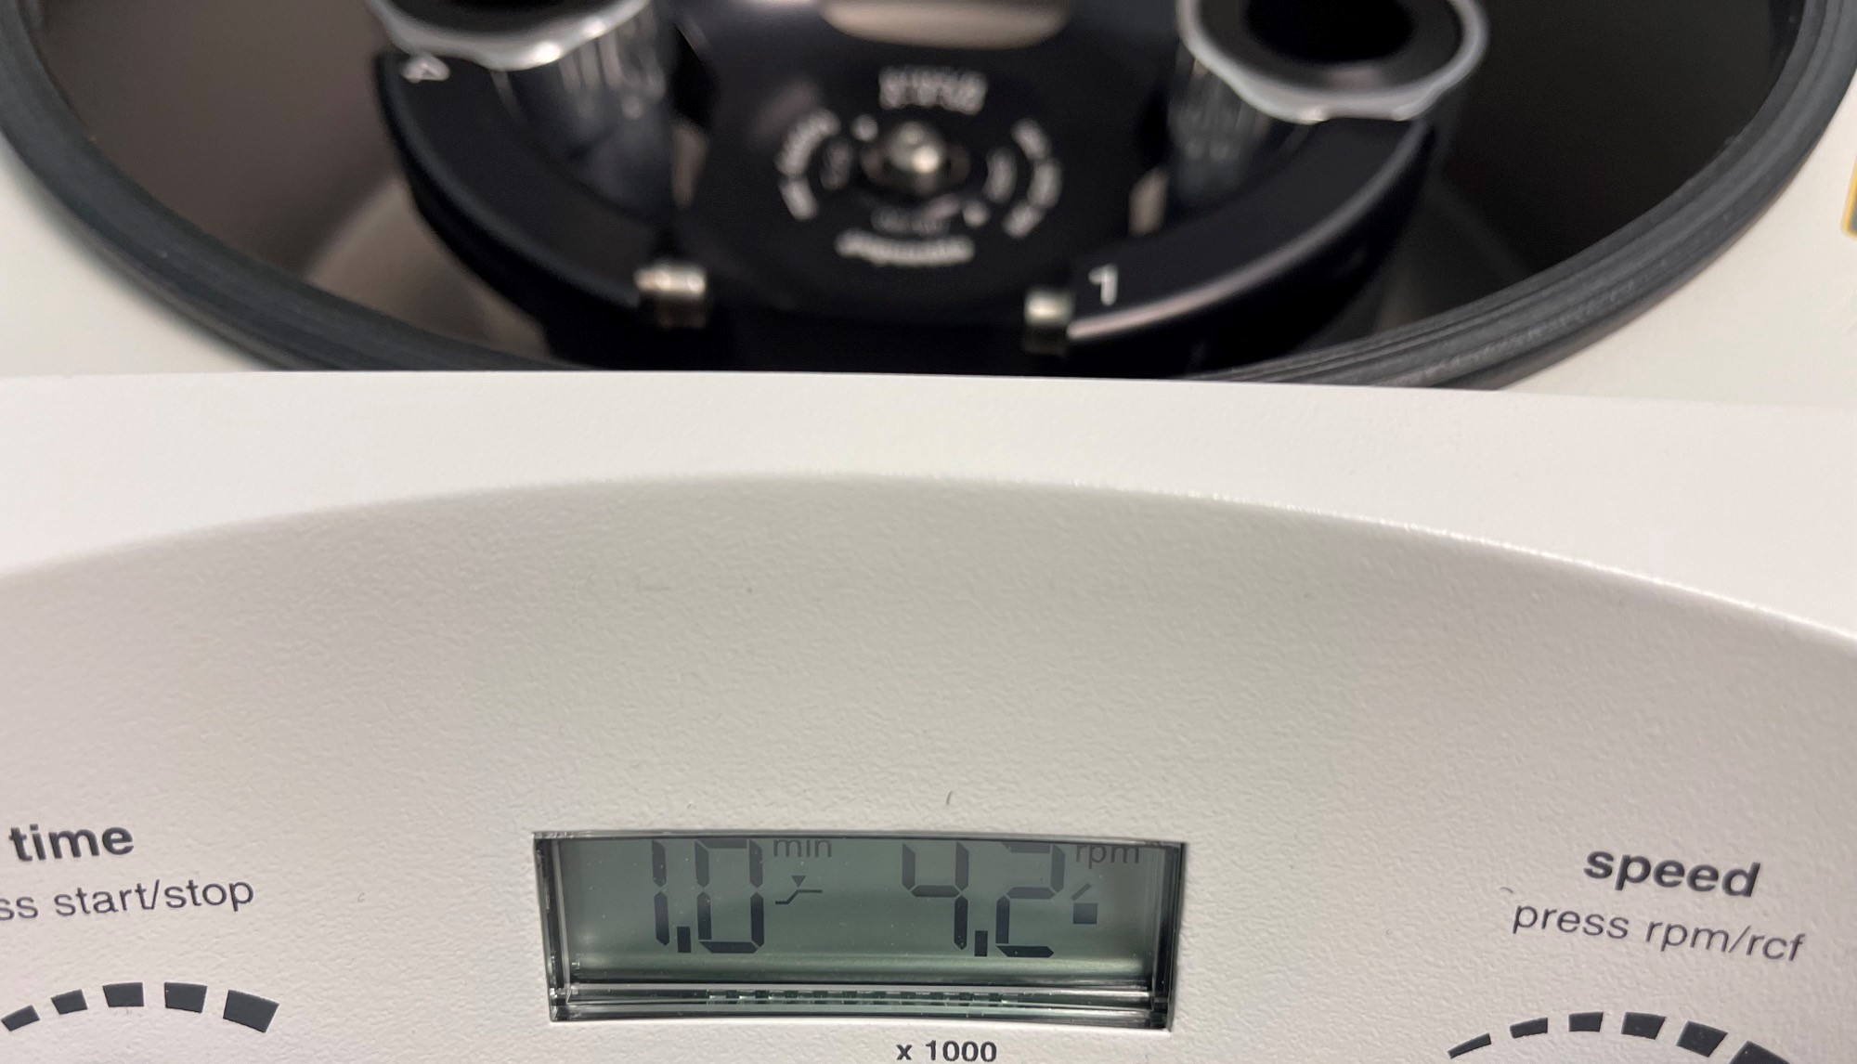
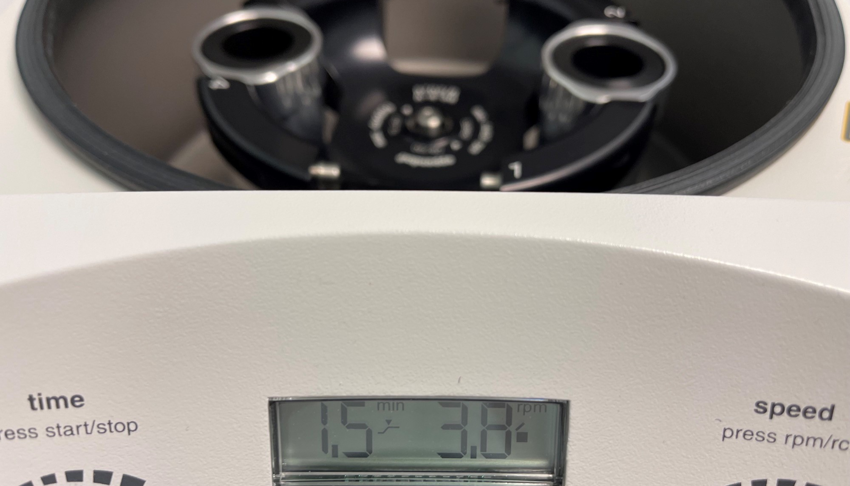
First Spin
30cc Kit
1 Minute @ 4200 RPM
60cc Kit
1.5 minutes @ 3800 RPM

Slide 9
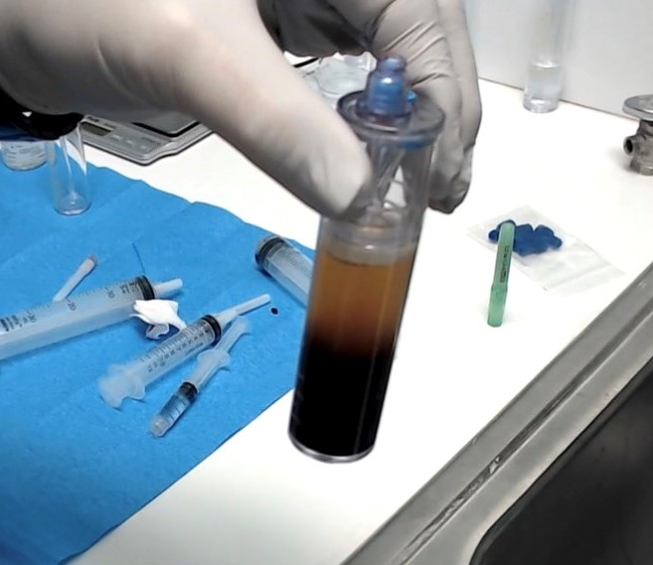
After first spin, the collection device will look like this….

Slide 10
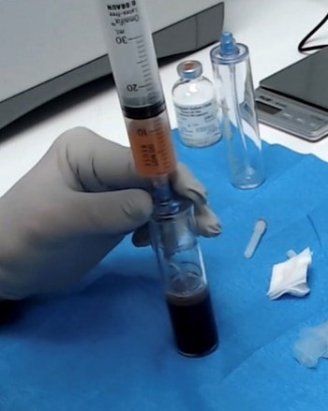
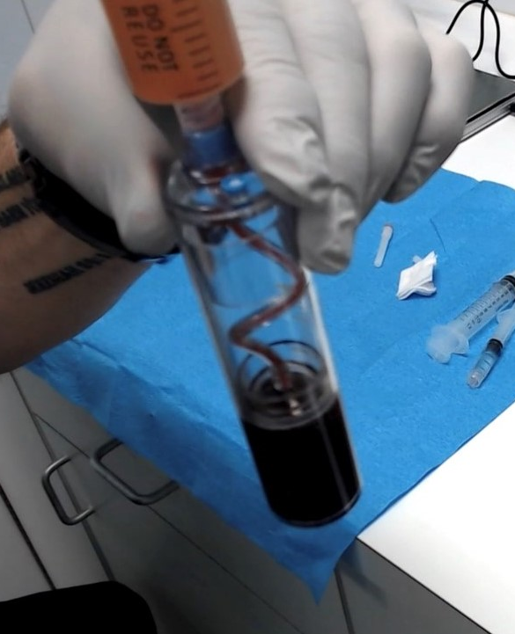
Pulling plasma from red cells
Pull plasma from red cells
Pull until you achieve a red flash in the inner tube
Place plasma in second concentrating tube
Weigh the second tube, and prepare counterbalance
Must be within 4 grams
Place in centrifuge bucket opposite counterbalance

Slide 11
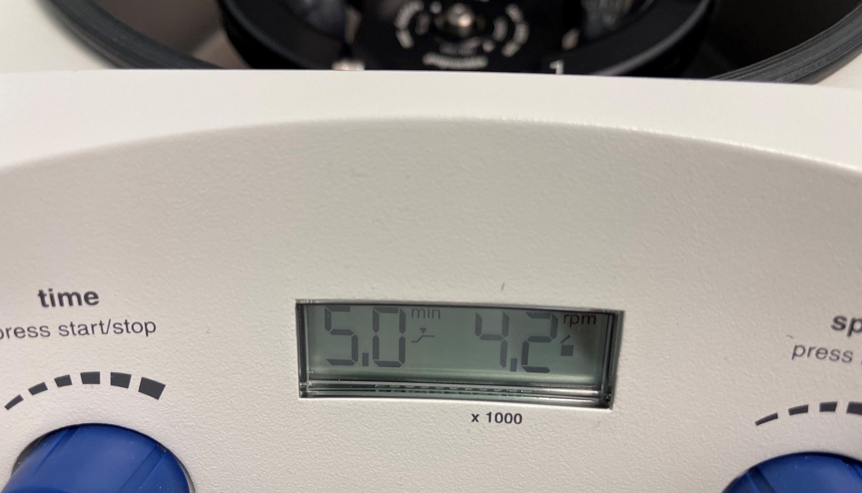
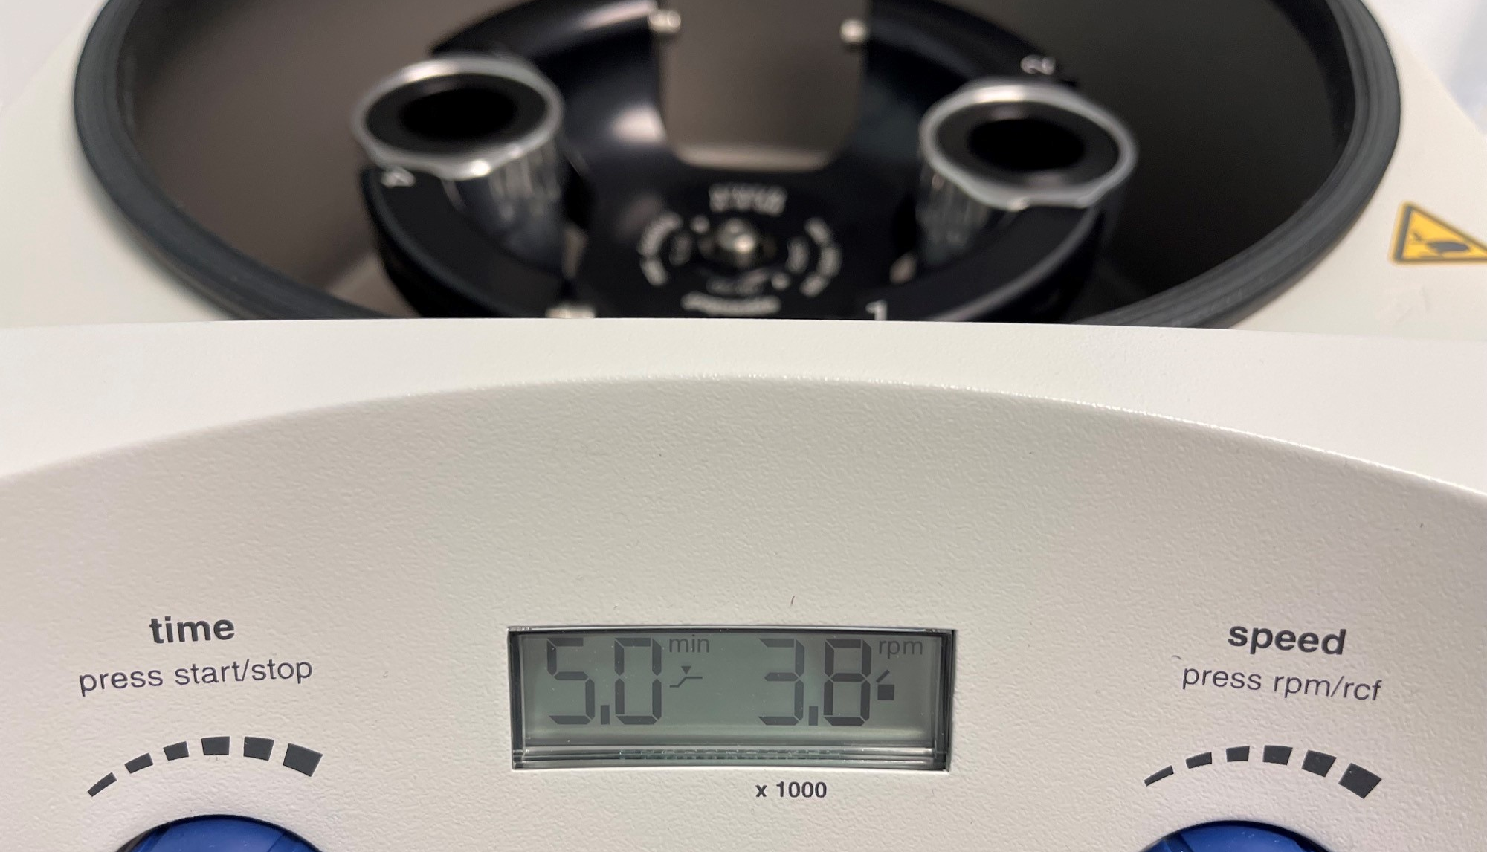
Second Spin
30cc Kit
5 Minute @ 4200 RPM
60cc Kit
5 minutes @ 3800 RPM

Slide 12
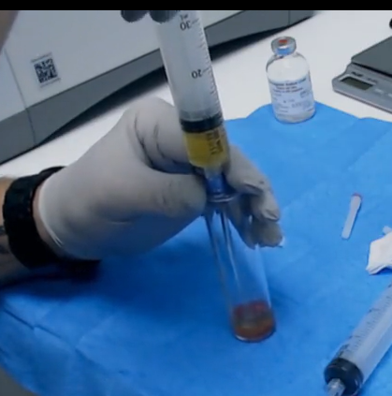
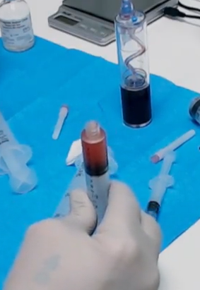
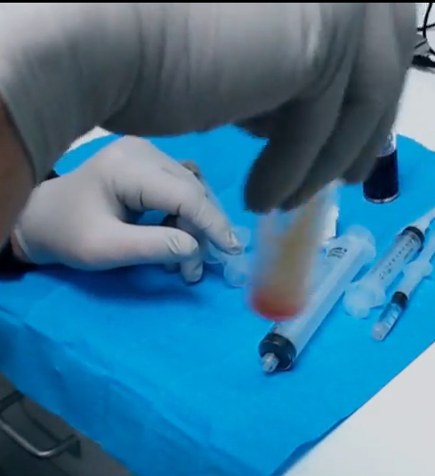
Concentrate the PRP according to the procedure you are performing
Remove the PPP (platelet-poor plasma) and leave the amount of fluid in the tube needed for the procedure.
Swirl the tube to resuspend the platelets into solution.
Pull the newly created platelet-rich plasma into the syringe needed for the injection

Slide 13
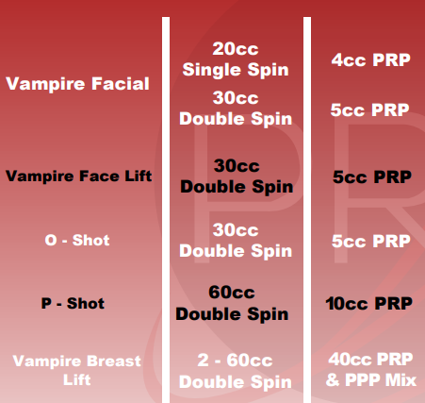
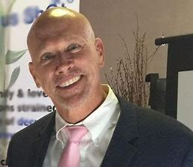
Volumes of PRP for Vampire® Procedures

Slide 14
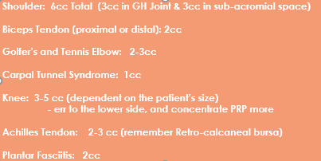
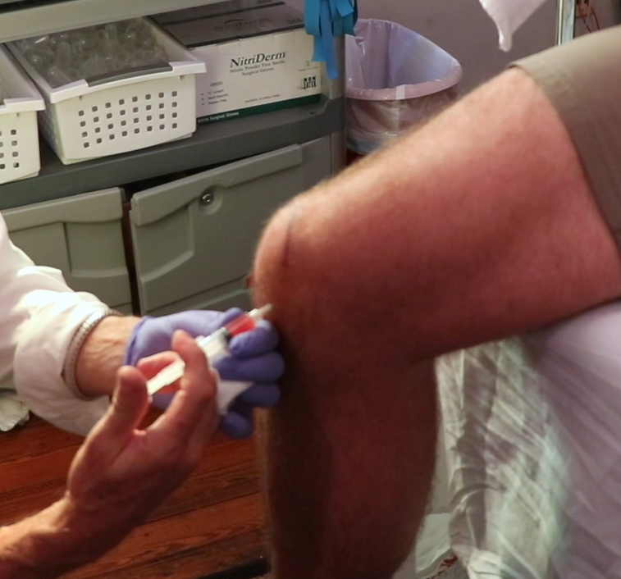
Volume of PRP for Musculoskeletal Injections

Slide 15

Find out how to take your PRP Practice to the next level
www.PerfectPRP.com

Slide 16
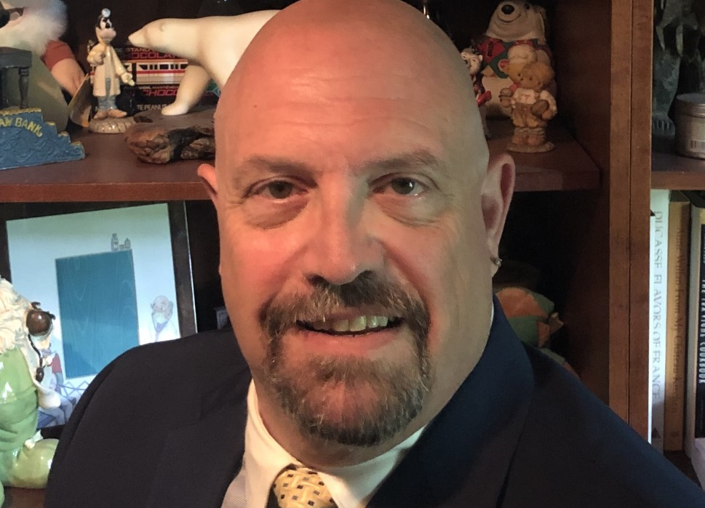
To make an appoint to discuss your PRP needs, or to have a
1–2-hour session with me to get your new centrifuge set-up
calendly.com/drjeff-regen

Slide 17
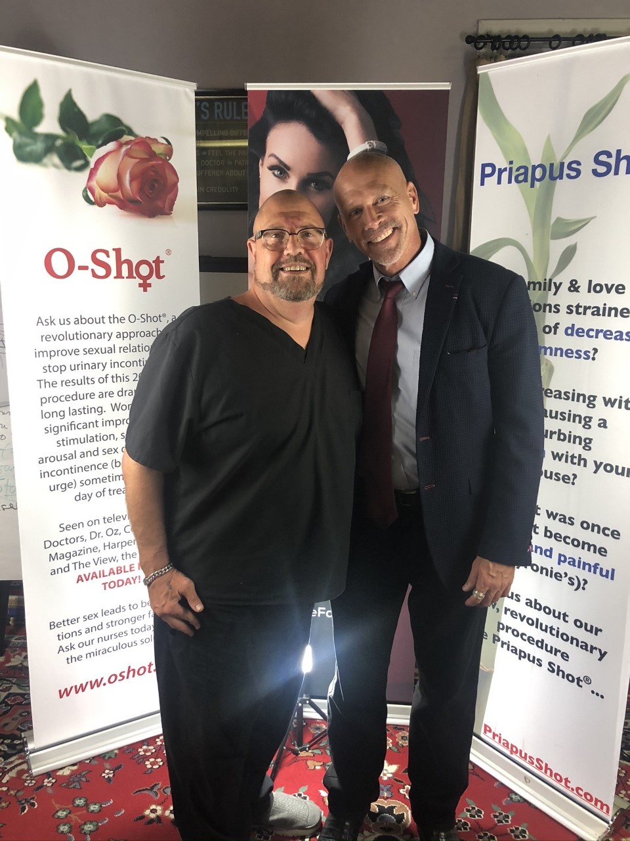
Contact Me
Jeffrey Piccirillo, DO
CEO/Founder Regenerative Medical Associates
DrJeff@regenmedicalgroup.com
Cell: 641-990-6737
www.Regenmedicalgroup.com
www.PerfectPRP.com
www.PerfectPRPthebook.com

